Slide 1

Presentation
ON
MALICIOUS SOFTWARE
PRESENTED TO
Falguni Roy
ASSISTANT PROFESSOR
INSTITUTE OF INFORMATION TECHNOLOGY
NOAKHALI SCIENCE & TECHNOLOGY UNIVERSITY

Slide 2


MEET
OUR
TEAM
SANZIDA SULTANA
BKH1825010F
ANUPA DAS SHORMI
BFH1925020F

Slide 3
CONTENTS
Types of Malicious Software (Malware)
Advanced Persistent Threat
Viruses
Worms
Spam E-Mail, Trojans
Payload—System Corruption
Payload—Attack Agent—Zombie, Bots
Payload—Information Theft—Keyloggers, Phishing, Spyware
Payload—Stealthing—Backdoors, Rootkits

Slide 4
WHAT
IS
MALWARE
MALWARE stands for malicious software.
A program that is inserted into a system, usually covertly, with the intent of compromising the confidentiality, integrity, or availability of the victim’s data, applications, or operating system or otherwise annoying or disrupting the victim.
Malware is used to gather sensitive information or to gain access to private systems.

Slide 5
Classification
OF
MALWARE
1.How it spreads or propagates to reach the desired targets.
2.The actions or payloads it performs once a target is reached.
3.Those that need a host program(parasitic code such as viruses).
4.Those that are independent,self-contained programs(worms,Trojans.and bots).
5.Malware that does not replicate(Trojans and spam e-mail).
6.Malware that does replicate(viruses and worms).

Slide 6
Types
OF
MALICIOUS SOFTWARE
Infection of existing content by viruses that is subsequently spread to other systems
Exploit of software vulnerabilities by worms or drive-by-downloads to allow the malware to replicate
Social engineering attacks that convince users to bypass security mechanisms to install Trojans to respond to phising attacks
Propagation mechanisms include:
Corruption of system or data files
Make the system a zombie agent of attack as part of botnet
Theft of information from the system/keylogging
Stealthing /hiding its presence on the system
Payload actions performed by malware once it reaches a target system can include

Slide 7
Attack KITS
Initially, the development and deployment of malware required considerable technical skill by software authors.
The development of virus-creation toolkits in the early 1990s, and then later of more general attack kits in the 2000s that greatly assisted in the development and deployment of malware
These toolkits, often known as crimeware.
Now include a variety of propagation mechanisms and payload modules that even novices can combine, select, and deploy.
These kits greatly enlarged the population of attackers able to deploy malware
variants that can be generated by attackers using these toolkits creates a significant problem for those defending systems against them.
Widely used toolkits include:
Zeus,Blackhole, Sakura, and Phoenix

Slide 8
ATTACK
Sources
Another significant malware development over the last couple of decades is the change from attackers being individuals, often motivated to demonstrate their technical competence to their peers, to more organized and dangerous attack sources.
Criminals
Organized
Crime
Organizations that sell their services to companies and nations
Politicallay motivated attackers
National government agencies
A large underground economy involving the sale of attack kits, access to compromised hosts, and to stolen information.

Slide 9
ADVANCE
Persistent
THREAT
An Advanced Persistent Threat (APT) is an organized cyberattack by a group of skilled, sophisticated threat actors. APTs are not “hit and run” attacks. Attackers plan their campaign carefully against strategic targets, and carry it out over a prolonged period of time.
Well-resourced, persistent application of a wide variety of intrusion technologies and malware to selected targets (usually business or political)
APTs differ from other types of attack by their careful target selection, and persistent, often stealthy, intrusion efforts over extended periods.
A number of high profile attacks including Aurora, RSA, APT1, and Stuxnet

Slide 10
Characteristics
OF
APT
Advance: Use by the attackers of a wide variety of intrusion technologies and malware, including the development of custom malware if required.
Persistent: Determined application of the attacks over an extended period against the chosen target in order to maximize the chance of success. A variety of attacks may be progressively, and often stealthily, applied until the target is compromised.
Threats: Threats to the selected targets as a result of the organized, capable, and well-funded attackers intent to compromise the specifically chosen targets. The active involvement of people in the process greatly raises the threat level from that due to automated attacks tools, and also the likelihood of successful attack.

Slide 11
What
IS
VIRUS
A computer VIRUS is a program or piece of code that is loaded onto our computer without our knowledge and runs against our wishes infects a host program
Modifies it to include a copy of the virus
Replicates and goes on to infect other content
Easily spread through network environments
When attached to an executable program a virus can do anything that the program is permitted to do
Executes secretly when the host program is run
May be specific to operating system and hardware
Takes advantages of their details and weaknesses

Slide 12
VIRUS Components
Infection mechanism
Trigger
Payload
It means by which a virus spreads or propagates, enabling it to replicate. The mechanism is also referred to as the infection vector.
:
The event or condition that determines when the payload is activated or delivered, sometimes known as a logic bomb
What the virus does, besides spreading. The payload may involve damage or may involve benign but noticeable activity.

Slide 13
VIRUS Phases
During its lifetime, a typical virus goes through the following four phases:
Dormant phase: The virus is idle. The virus will eventually be activated by some event, such as a date, the presence of another program or file, or the capacity of the disk exceeding some limit. Not all viruses have this stage.
Propagation phase: The virus places a copy of itself into other programs or into certain system areas on the disk. The copy may not be identical to the propagating version; viruses often morph to evade detection. Each infected program will now contain a clone of the virus, which will itself enter a propagation phase.
Triggering phase: The virus is activated to perform the function for which it was intended. As with the dormant phase, the triggering phase can be caused by a variety of system events, including a count of the number of times that this copy of the virus has made copies of itself.
Execution phase: The function is performed. The function may be harmless, such as a message on the screen, or damaging, such as the destruction of programs and data files.
Propogation
Trigger
Execution
Dormant

Slide 14
Classification
OF
VIRUS
There is no simple or universally agreed upon classification scheme for viruses. In this section, we classify viruses along two orthogonal axes: the type of target the virus tries to infect and the method the virus uses to conceal itself from detection by users and anti-virus software.
A virus classification by target includes the following categories:
Boot sector infector:
Infects a master boot record and spreads when a system is booted from the disk containing the virus.
File infector:
Infects files that the operating system or shell consider to be executable.
Macro virus:
Infects files with macro or scripting code that is interpreted by an application.
Multipartite virus:
Infects files in multiple ways. Typically, the multipartite virus is capable of infecting multiple types of files, so that virus eradication must deal with all of the possible sites of infection

Slide 15
A virus classification by concealment strategy includes the following categories:
Encrypted virus:
A portion of the virus creates a random encryption key and encrypts the remainder of the virus. The key is stored with the virus. When an infected program is invoked, the virus uses the stored random key to decrypt the virus.
Stealth virus:
A form of virus explicitly designed to hide itself from detection by anti-virus software. Thus, the entire virus, not just a payload is hidden. It may use code mutation, compression, or rootkit techniques to achieve this.
Polymorphic virus:
A form of virus that creates copies during replication that are functionally equivalent but have distinctly different bit patterns, in order to defeat programs that scan for viruses. In this case, the “signature” of the virus will vary with each copy. The portion of the virus that is responsible for generating keys and performing encryption/decryption is referred to as the mutation engine. The mutation engine itself is altered with each use.
Metamorphic virus:
As with a polymorphic virus, a metamorphic virus mutates with every infection. The difference is that a metamorphic virus rewrites itself completely at each iteration, using multiple transformation techniques, increasing the difficulty of detection. Metamorphic viruses may change their behavior as well as their appearance

Slide 16
MACRO
AND Scripting VIRUSES
In the mid-1990s, macro or scripting code viruses became by far the most prevalent type of virus.
Macro viruses are particularly threatening for a number of reasons:
A macro virus is platform independent. Many macro viruses infect active content in commonly used applications, such as macros in Microsoft Word documents or other Microsoft Office documents, or scripting code in Adobe PDF documents. Any hardware platform and operating system that supports these applications can be infected.
Macro viruses infect documents, not executable portions of code. Most of the information introduced onto a computer system is in the form of documents rather than programs.
3. Macro viruses are easily spread, as the documents they exploit are shared in normal use. A very common method is by electronic mail.
4. Because macro viruses infect user documents rather than system programs, traditional file system access controls are of limited use in preventing their spread, since users are expected to modify them.

Slide 17
WORMS
A worm is a program that actively seeks out more machines to infect, and then each infected machine serves as an automated launching pad for attacks on other machines. Worm programs exploit software vulnerabilities in client or server programs
Can use network connections to spread from system to system
Also spread through shared media(USB drives, CD, DVD , data disks)
It also spread in macro or script code included in attachments and instant messenger file transfers
Upon activation the worm may replicate and propagate again

Slide 18
WORM
Replication
To replicate itself, a worm uses some means to access remote systems. These include the following:
Electronic mail or instant messenger facility:
A worm e-mails a copy of itself to other systems, or sends itself as an attachment via an instant message service, so that its code is run when the e-mail or attachment is received or viewed.
File sharing:
A worm either creates a copy of itself or infects other suitable files as a virus on removable media such as a USB drive; it then executes when the drive is connected to another system using the auto run mechanism by exploiting some software vulnerability, or when a user opens the infected file on the target system.
Remote execution capability:
A worm executes a copy of itself on another system, either by using an explicit remote execution facility or by exploiting a program flaw in a network service to subvert its operations
Remote file access or transfer capability:
A worm uses a remote file access or transfer service to another system to copy itself from one system to the other, where users on that system may then execute it.
Remote login capability:
A worm logs onto a remote system as a user and then uses commands to copy itself from one system to the other, where it then executes.

Slide 19
TARGET Discovery
Scanning
First function in the propagation phase for a network worm. Searches for other systems to infect.
Scanning strategies that a Worm can use is given below:
Random:
Each compromised host probes random addresses in the IP address space, using a different seed. This technique produces a high volume of Internet traffic, which may cause generalized disruption even before the actual attack is launched.
Hit-List:
The attacker first compiles a long list of potential vulnerable machines. This can be a slow process done over a long period to avoid detection that an attack is underway. Once the list is compiled, the attacker begins infecting machines on the list. Each infected machine is provided with a portion of the list to scan. This strategy results in a very short scanning period, which may make it difficult to detect that infection is taking place.
Topological:
This method uses information contained on an infected victim machine to find more hosts to scan
Local subnet:
If a host can be infected behind a firewall, that host then looks for targets in its own local network. The host uses the subnet address structure to find other hosts that would otherwise be protected by the firewall.

Slide 20
State OF WORM Technology
The state of the art in worm technology includes the following:
Multiplatform: Newer worms are not limited to Windows machines but can attack a variety of platforms, especially the popular varieties of UNIX; or exploit macro or scripting languages supported in popular document types.
Multi-exploit: New worms penetrate systems in a variety of ways, using exploits against Web servers, browsers, e-mail, file sharing, and other network-based applications; or via shared media.
Ultrafast spreading: Exploit various techniques to optimize the rate of spread of a worm to maximize its likelihood of locating as many vulnerable machines as possible in a short time period.
Polymorphic: To evade detection, skip past filters, and foil real-time analysis, worms adopt virus polymorphic techniques. Each copy of the worm has new code generated on the fly using functionally equivalent instructions and encryption techniques.
Metamorphic: In addition to changing their appearance, metamorphic worms have a repertoire of behavior patterns that are unleashed at different stages of propagation.
Transport vehicles: Because worms can rapidly compromise a large number of systems, they are ideal for spreading a wide variety of malicious payloads, such as distributed denial-of-service bots, rootkits, spam e-mail generators, and spyware.
Zero-day exploit: To achieve maximum surprise and distribution, a worm should exploit an unknown vulnerability that is only discovered by the general network community when the worm is launched.

Slide 21
MOBILE CODE
Programs that can be shipped unchanged to a variety of platforms including Java applets, ActiveX ,and JavaScript
Transmitted from a remote system to a local system and then executed on the local system
Often acts as a mechanism for a virus , worm or Trojan horse
MOBILE Phone worms
Target is the smartphone
First discovery was Cabir worm in 2004
Then Lasco and CommWarrior in 2005
Spreads through Bluetooth wireless connections or MMS(Multimedia Messaging Service)
Can completely disable the phone,delete data on the phone ,or force the device to send costly messages.

Slide 22
DRIVE- By -Downloads
Exploits browser vulnerabilities to download and installs malware on the system when the user view a Web page controlled by the attacker
In most cases does not actively propagate
Spreads when users visit the malicious Web page
Watering-hole attacks
The attacker researches their intended victims to identify web sites they are likely to visit, and then scans these sites to identify those with vulnerabilities that allow their compromise with a drive-by-download attack. They then wait for one of their intended victims to visit one of the compromised sites.
Their attack code may even be written so that it will only infect systems belonging to the target organization, and take no action for other visitors to the site. This greatly increases the likelihood of the site compromise remaining undetected.
Malvertising
The attacker pays for advertisements that are highly likely to be placed on their intended target websites, and which incorporate malware in them. Using these malicious adds, attackers can infect visitors to sites displaying them.

Slide 23
Clickjacking
Also known as a user-interface (UI) redress attack
Vulnerability used by an attacker to collect an infected user’s clicks
The attacker is hijacking clicks meant for one page and routing them to another page.
The attacker can force the user to do a variety of things from adjusting the user’s computer settings to unwittingly sending the user to Web sites that might have malicious code
Also, by taking advantage of Adobe Flash or JavaScript, an attacker could even place a button under or over a legitimate button, making it difficult for users to detect.
Similar to clicks , keystrokes can also be hijacked .

Slide 24
SPAM E-mail
Spam is a significant carrier of malware.
The e-mail may have an attached document which ,if opened,may exploit a software vulnerability to install malware on the user’s system
Or, it may have an attached Trojan horse program or scripting code that,if run,installs malware.
It may be used in a phishing attack
Directing the user either to a fake Web site that mirrors some legitimate service, such as an online banking site, where it attempts to capture the user’s login and password details.
Or to complete some form with sufficient personal details to allow the attacker to impersonate the user in an identity theft
Requires the user’s active choice to view the e-mail and any attached document, or to permit the installation of some program, in order for the compromise to occur.

Slide 25
TROJAN Horses
A Trojan horse is a useful, or apparently useful, program or utility containing hidden code that, when invoked, performs some unwanted or harmful functions.
For examples a Trojan horse program can scan the user’s files for the desired sensitive information and sends a copy of it to the attacker via a Web form or e-mail or text message.
The Trojan horse program may be bundled with a game or useful utility program and made available on a software distribution site or app store.
Three Models
Continuing to perform the function of the original program and additionally performing a separate malicious activity.
Continuing to perform the function of the original program but modifying the function to perform malicious activity (e.g., a Trojan horse version of a login program that collects passwords) or to disguise other malicious activity (e.g., a Trojan horse version of a process listing program that does not display certain processes that are malicious).
Performing a malicious function that completely replaces the function of the original program

Slide 26



Payload-System Corruption
Resulted in data destruction on the infected system when certain trigger conditions were met .
Displays unwanted messages or content on the user’s system when triggered.
These changes may not occur immediately, but only when specific trigger conditions are met that satisfy their logic-bomb code.

Slide 27
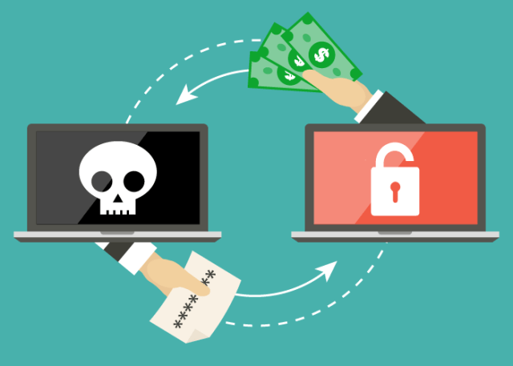
.
RANSOMWARE
Ransomware is a malware that is installed unnoticed on the PC of a stranger.
The malware encrypts either the files or the entire computer.
The hacker has control over the computer, and demands a ransom. As long as the victim does not pay the ransom, the device stays encrypted.
If the infected device is in a network, such as in a company, the malware can spread to the entire network and encrypt all devices on that network.

Slide 28

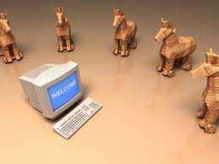
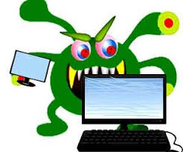
DATA Destruction: History
Chernobyl virus
PC Cyborg Trojan
Klez mass-mailing worm
First occurred 1999,infects executable files, deletes data on the infected system
First seen 1989, when boot count reached 90, it hide directories and encrypts the names of all files on drive C ,user needed to pay ransom.
First seen in October 2001, spreads by e-mailing copies, stop and delete some anti-virus programs running on the system

Slide 29
Real world DAMAGE
A further variant of system corruption payloads aims to cause damage
to physical equipment
The Chernobyl virus not only corrupts data, but attempts to rewrite the BIOS code
used to initially boot the computer
The boot process fails, and the system is unusable until the BIOS chip is either re-programmed or replaced.

Slide 30
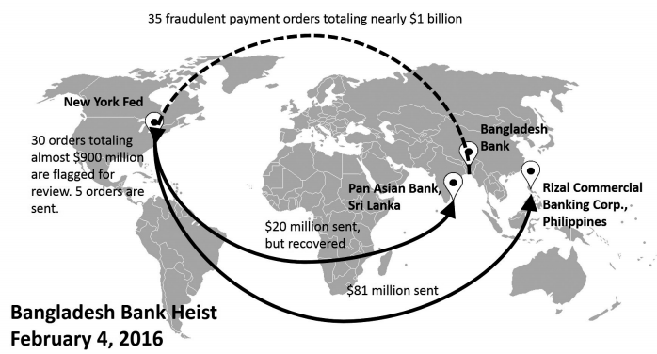
Real world DAMAGE
Bangladesh bank robbery:
On February 2016, thirty-five fraudulent instructions were issued by security hackers via the swift network.
Five of the thirty-five fraudulent instructions were successful in transferring US$101 million, with US$20 million traced to Sri Lanka and US$81 million to the Philippines.
affect the system hardware and os.

Slide 31
LOGIC Bomb
Start
Logic bomb is code embedded in the malware is set to “explode” when certain conditions are met.
Input
Input
=
Logic Bomb
Value
Yes
Activate
Dormant Code
Makes their presence undetected until it
executes their function.
No
Once triggered, a bomb may alter or delete data
or entire files, cause a machine halt, or do some
other damage.
Execute
Genuine Code
Execute Hidden
Malicious Code
End of
Program
End

Slide 32

PayLoad : BOTNET Or Zombie Army
A botnet is a collection of infected machine which are coordinate through command and control by a central server.
A bot also called a zombie or drone is a device infected by malicious code, which then becomes part of a network.
The bot is typically planted on hundreds or thousands of computers belonging to unsuspecting third parties.
One infected device is a bot (robot). A collection of these bots forms a botnet (robot network).

Slide 33
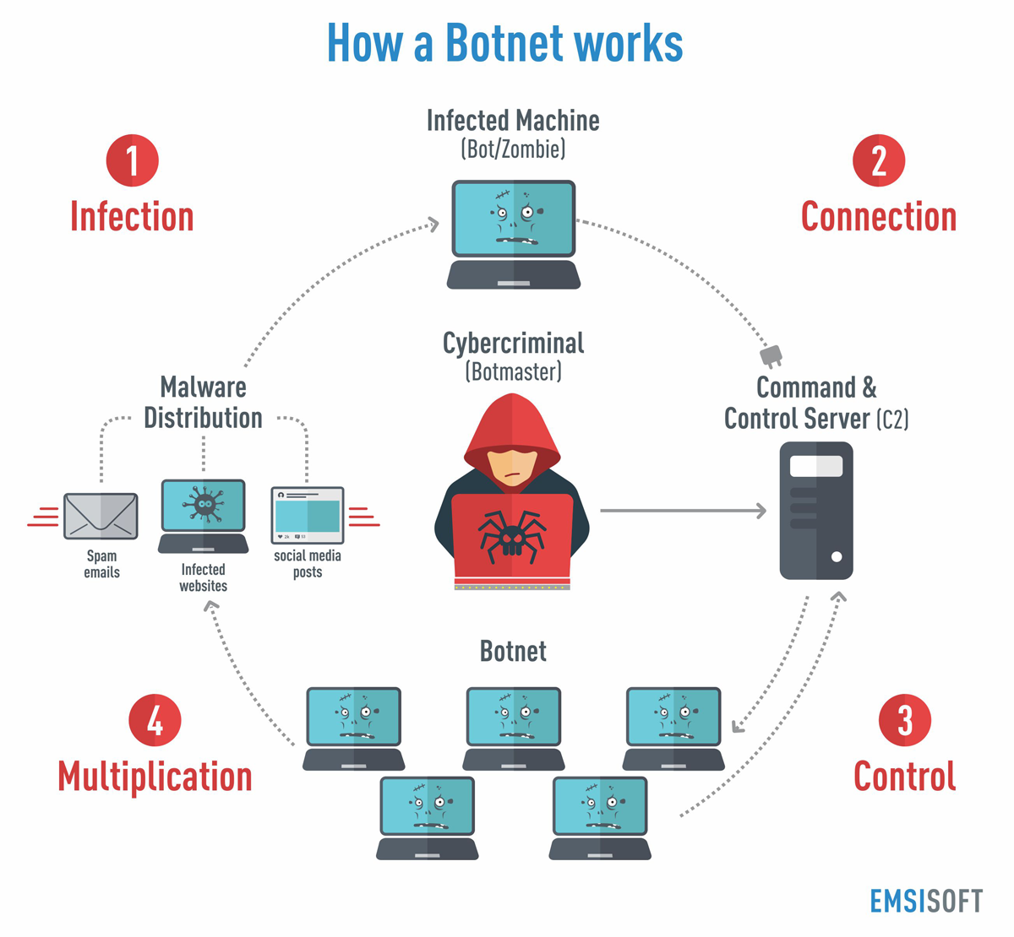

Slide 34



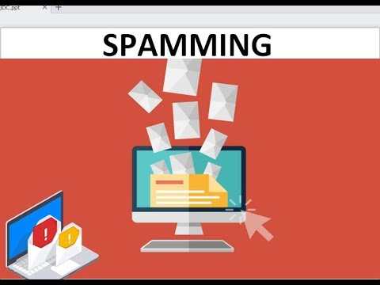

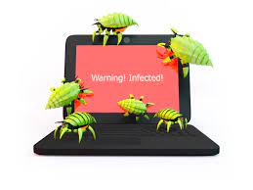

Uses of Bots
Keylogging
Sniffing traffic
Keylogging
03
04
Installing advertisement add-ons and browser helper objects
Installing advertisement add-ons and browser helper objects
Sppaming
02
05
Manipulating online polls/games
01
DDoS attacks
06

Slide 35
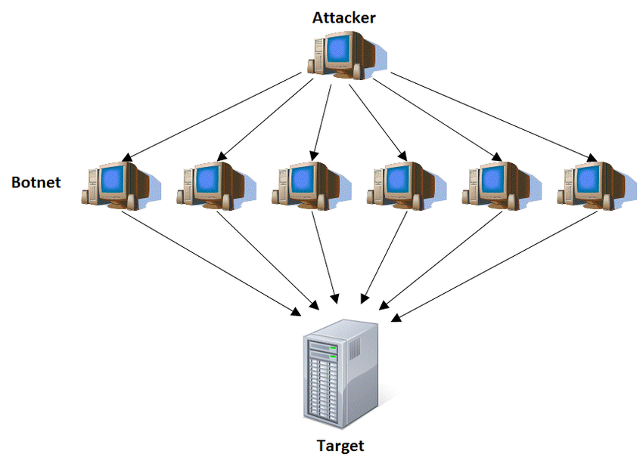
Uses of Bots
DDos Attack:
Distributed Denial of Service (DDoS) takes advantage of the specific capacity limits that apply to any network resources
The DDoS attack will send multiple request to the attacked web resource –with the aim of exceeding the website’s capacity .
Typical targets for DDoS attacks include:
Internet shopping sites
Any business or organisation that depends on
providing online service

Slide 36

Uses of Bots
Sniffing traffic:
Bots can also use a packet sniffer to watch for interesting clear text data passing by a compromised machine.
The sniffers are mostly used to retrieve sensitive information like usernames and passwords

Slide 37
Uses of Bots
Keylogging:
Keylogger is a type of monitoring software designed to record keystrokes made by a user.
Collect information and send it back to a third party.
Keystroke logging software is one of the oldest forms of malware . It's still popular and often used as part of larger cyber attacks.

Slide 38
Uses of Bots
Installing advertisement add-ons and browser helper objects (BHOs):
Botnets can also be used to gain financial advantages.
The operator of Web site negotiates a deal with some hosting companies that pay for clicks on ads.
With the help of a botnet, these clicks can be “automated” so that instantly a few thousand bots click on the pop-ups

Slide 39
Uses of Bots
Manipulating online polls/games:
Online polls/games easy to manipulate with botnets.
In botnet every bot has a distinct IP address, every vote will have the same credibility as a vote cast by a real person.

Slide 40
Uses of Bots
Distinguishes a bot from worm
Worm propagates itself and activates itself
Bot is controlled by some form of command- and-control (C&C) server network.
Typical means of implementing the remote control facility is on an IRC Server
Bots join a specific channel on this server and treat incoming messages as commands
More recent botnets use coverts communication channel via protocol such as HTTP

Slide 41
Credential Theft
Users send their login and password credentials to banking, gaming, and related sites over encrypted communication channels like HTTPS which protects them from capture by monitoring network packets
To bypass this, an attacker can install a keylogger.
Some banking and other sites switched to using a graphical applet to enter critical information, such as password.
In response, attackers developed more general spyware payloads which include monitoring the history and content of browsing activity, redirecting certain Web page requests to fake sites .

Slide 42

Phishing and Identity Theft
Phishing is a cybercrime where criminals impersonate legitimate organizations via email, text message, advertisement or other means in order to steal sensitive information personally identifiable information, passwords, credit card numbers etc.
Normally included in some message suggesting that urgent action is required by the user to authenticate their account, to prevent it being locked.
The first phishing lawsuit was filed in 2004 against a Californian teenager who created website “America Online” and able to gain sensitive information from users.

Slide 43
Backdoor
A backdoor is a secret entry point into a program that allows someone who is aware of the backdoor to gain access without going through the usual security access procedures.
A developer may create a backdoor so that an application or operating system can be accessed for troubleshooting or other purposes.
Backdoors become threats when unscrupulous programmers use them to gain unauthorized access.
Attacker often use backdoor that they detect or install themselves to access the victim device.
It is difficult to implement controls for backdoors in applications.

Slide 44
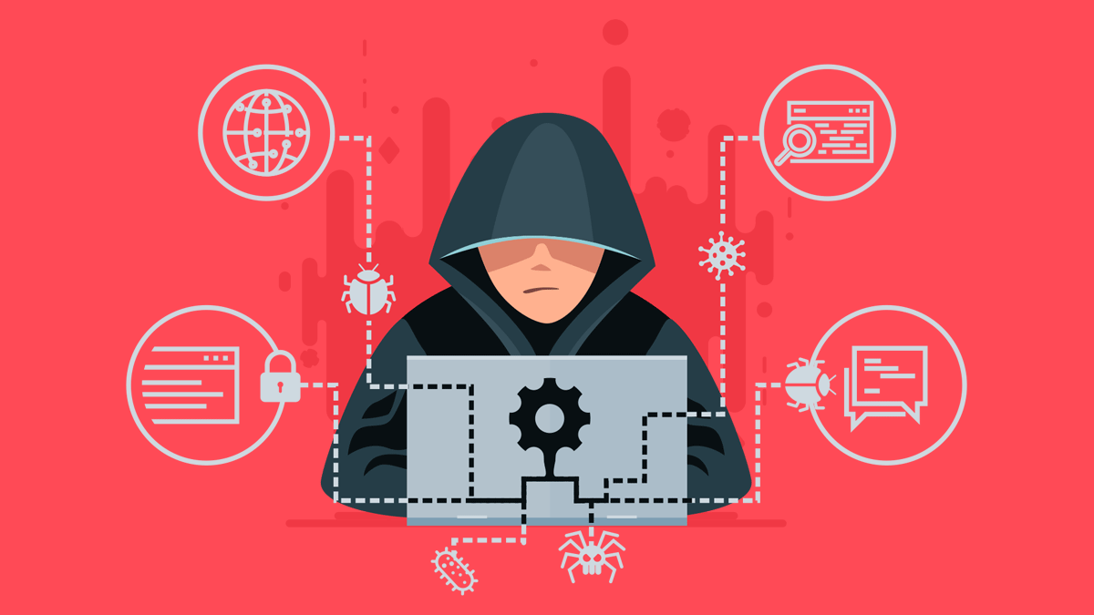
Rootkit
A rootkit allows someone to maintain command and control over a computer without the computer user/owner knowing about it.
This provides access to all the functions and services of the operating system.
With root access, an attacker has complete control of the system and can add or change programs and files, monitor processes.

Slide 45
Characteristics of Rootkit
Persistent
Memory based
User mode
Kernel mode
Virtual machine based
External mode

Slide 46
Kernel Mode Rootkits
Programs operating at the user level interact with the kernel through system calls.
Thus, system calls are a primary target of kernel-level rootkits to achieve concealment.
The kernel maintains a system call table with one entry per system call routine.
The syscall number serves as an index into the system call table.

Slide 47
Kernel Mode Rootkit
sys_call_table
evil_sys_read()
{
…
//parameter change
sys_read();
//copy results
…
}
sys_exit
sys_read()
{
…
}
sys_fork
evil_sys_read
sys_read
sys_write

Slide 48
Three techniques that can be used to change system calls
The attacker modifies selected syscall addresses stored in the system call table. This enables the rootkit to direct a system call away from the legitimate routine to the rootkit’s replacement.
Modify the system call table
01
Modify system call table targets
02
The attacker overwrites selected legitimate system call routines with malicious code.
The attacker redirects references to the entire system call table to a new table in a new kernel memory location.
Redirect the system call table
03

Slide 49
Antivirus Approaches
Prevention : Do not allow a virus to get into the system (in general, impossible to achieve)
Detection: Once infection has occurred, determine that it has occurred and locate the virus;
Identification: Once a virus is detected, identify it;
Removal: Once the specific virus has been identified, remove all traces of the virus and restores the infected programs to their original state.

Slide 50
HOST-BASED BEHAVIOR-BLOCKING SOFTWARE
Behavior-blocking software integrates with the operating system of a host computer and monitors program behavior in real time for malicious actions.
The behavior blocking software then blocks potentially malicious actions before they have a chance to affect the system.
Potentially malicious actions may include:
• Attempts to open, view, delete, modify files
• Attempts to format disk drives, etc
• Modification of system settings (start-up,etc)
• Initiation of network communication

Slide 51
ROOTKIT COUNTERMEASURES
Rootkits can be extraordinarily difficult to detect and neutralize.
Countering rootkits requires a variety of network and computer level security tools.
A system needs to look for behaviors that could indicate the presence of a rootkit, such as the interception of system calls or a keylogger interacting with a keyboard driver.
If a kernel-level rootkit is detected, the only secure and reliable way to recover is to do an entire new OS install on the infected machine.

Slide 52
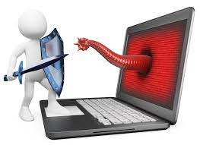
Prevent Malicious Software
Always Update device Operating System.
Think twice before clicking links or downloading anything.
Be careful about opening email attachments or images.
Don't trust pop-up windows that ask you to download software.
Only Use Trusted Antivirus and Malware Software.
Rely Only On Secure Networks (Encrypted)

Slide 53
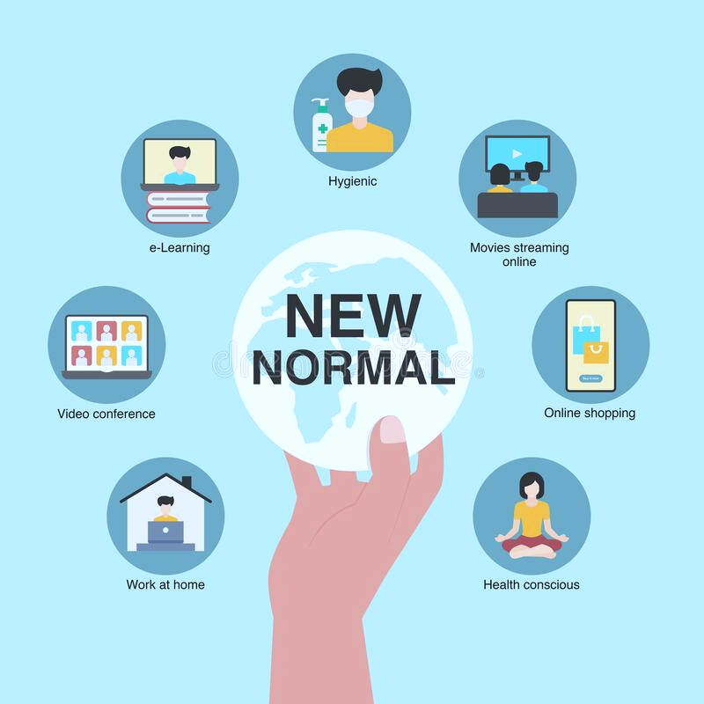
A Big Thank you!

